Slide 1

Introducción al análisis de sistemas de tiempo real
Nociones básicas y recursos disponibles
Julio Medina
(Parte de este material está basado en un tutorial realizado en el Software Engineering Institute,
Carnegie Mellon University)

Slide 2
Contenidos
Propiedades y definición de sistema de tiempo real.
Requisitos temporales y diferencias entre sistemas convencionales y de tiempo real.
Estrategias para la planificación de los procesos, ejemplo.
Políticas de planificación.
Necesidad del modelado y análisis de tiempo real. Efectos de la arquitectura. Un caso de estudio.
Test de utilización
Recursos y herramientas para docencia e investigación.

Slide 3
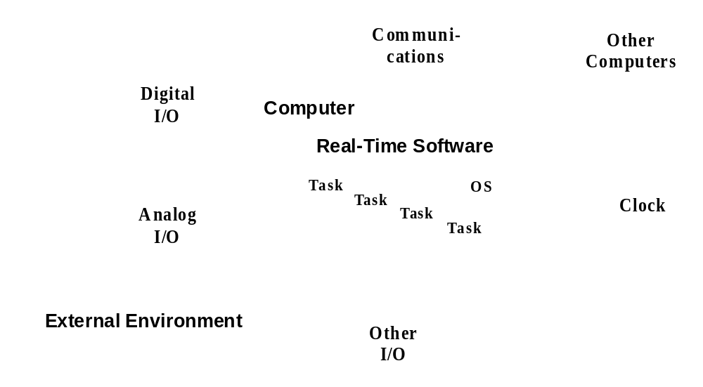
Definición y propiedades de los sistemas de tiempo real
Notes:
In many real-time systems the activities that the system must execute are known in advance, and the code is active in the computer memory, ready to execute. The execution of each of the different activities is triggered by the arrival of a stimulus called an event. Examples of events are those produced by a clock to activate periodic activities, an interrupt request from a HW device, etc.
The activity itself that is triggered by the event is called a response. Since each response is usually implemented as an independent thread of control called a task, we will make no further distinction between responses and tasks (sometimes, a response may be implemented using several tasks, or no tasks at all, but we can think of a response as a conceptual task).
During the execution of the response, different system resources may be needed, such as the CPU, pieces of shared data, hardware devices, etc. Since a response may be rather complex depending on the kinds of resources needed to execute each part, we will decompose a response into one or more actions. An action is characterized because it uses a certain number of resources during all of its execution, and it does not change the scheduling parameters used to request those resources.
The execution of the response (and sometimes of the individual actions) may have timing requirements that must be met. In many cases the timing requirement refers to the maximum response time that is allowed for the response, counting from the arrival of the triggering event. This kind of requirement is called a deadline.

Slide 4
Sistema de tiempo real
Un sistema de tiempo real es una combinación de un sistema físico de cómputo, dispositivos de entrada salida y software de propósito específico para los que:
  Se da una fuerte interacción con el entorno
  El entorno cambia en el tiempo
  El Sistema controla y a la vez reacciona a los estímulos del entorno
Por ello:
  El software tiene impuestos requisitos temporales
  Y conviene organizarlo de manera similar a la concurrencia real del entorno
  A fin de garantizar que los requisitos temporales se cumplen, el comportamiento temporal del sistema en su conjunto ha de ser predecible.
Notes:
In many real-time systems the activities that the system must execute are known in advance, and the code is active in the computer memory, ready to execute. The execution of each of the different activities is triggered by the arrival of a stimulus called an event. Examples of events are those produced by a clock to activate periodic activities, an interrupt request from a HW device, etc.
The activity itself that is triggered by the event is called a response. Since each response is usually implemented as an independent thread of control called a task, we will make no further distinction between responses and tasks (sometimes, a response may be implemented using several tasks, or no tasks at all, but we can think of a response as a conceptual task).
During the execution of the response, different system resources may be needed, such as the CPU, pieces of shared data, hardware devices, etc. Since a response may be rather complex depending on the kinds of resources needed to execute each part, we will decompose a response into one or more actions. An action is characterized because it uses a certain number of resources during all of its execution, and it does not change the scheduling parameters used to request those resources.
The execution of the response (and sometimes of the individual actions) may have timing requirements that must be met. In many cases the timing requirement refers to the maximum response time that is allowed for the response, counting from the arrival of the triggering event. This kind of requirement is called a deadline.

Slide 5
Requisitos temporales
En las aplicaciones de tiempo real, la corrección de un cómputo no depende solo de la corrección de sus cálculos, sino también del instante en el que estos son generados o impuestos sobre el entorno que los requiere.
Requisitos temporales:
  Actividades periódicas, o requeridas a intervalos regulares
      El trabajo asociado ha de terminarse antes del plazo asignado
  Respuestas a eventos esporádicos, o requeridos a intervalos irregulares
      En ocasiones sujetas a plazos
      O sujetas a requisitos de respuesta promedio
  Asegurar que los plazos críticos se satisfacen aún en las sobrecargas temporales
  Asegurar la coherencia de los datos/recursos compartidos
Notes:
Real-time systems generally consist of independently schedulable threads of control called tasks. Here the term task refers to any schedulable unit of processing, like a process or thread.
Tasks may be periodic or aperiodic
Periodic tasks are initiated at regular intervals.
Aperiodic tasks are initiated at irregular intervals.
Tasks have deadlines which may be hard or soft.
Failure to meet hard deadlines results in system failure.
Failure to meet soft deadlines degrades system performance.
Tasks may be further categorized as being critical or non-critical. Failure of a critical task to meet a hard deadline (if one exists) is considered catastrophic.

Slide 6
Diferencias entre sistemas convencionales y sistemas de tiempo real
Es la necesidad de ser predecibles la que los distingue:
La garantía de haber explorado el PEOR caso no puede obtenerse en base a pruebas
 | Tiempo compartido | Tiempo real
Capacidad | Máximo rendimiento | Requisitos temporales
Respuesta | Más rápida en promedio | Para la máxima latencia
Sobrecarga | Reparto equitativo | Estabilidad en caso crítico
Notes:
In time-sharing systems, the measures of merit are high throughput, fast average response time, and fairness to all the users. Different measures of merit are appropriate for real-time systems, and these different measures make real-time programming substantively different from non-real-time programming. In particular, non-real-time programming is often concerned with improving average-case performance, but real-time programming is typically concerned with ensuring that worst-case behavior is acceptable.
In real-time systems, the ability to meet deadlines is paramount. Schedulability is the appropriate measure of this requirement, while in other kinds of systems, average throughput is a good measure. Schedulability can be thought of as a refinement of the throughput measure by counting only those tasks that can meet their deadlines.
In real-time systems, latency or worst-case response for hard real-time tasks is used as a criterion, while fast average response time is retained as a measure for soft real-time tasks. However, the notion of fairness is discarded and replaced with the new notion of stability.
Both fairness and stability concern the characteristics of system resource allocation. In a real-time system, when all the timing constraints are met, there will be no starvation and fairness is not an issue. When it is impossible to meet all the timing constraints, we must ensure the deadlines of critical tasks, even at the cost of starving non-critical tasks, i.e., the notion of fairness is not appropriate.

Slide 7
Estrategias de planificación
Decididas en tiempo de compilación
  Por slots de tiempo fijo o ejecutivos cíclicos
  Planificación estática
  La estructura lógica de la aplicación se ve influenciada por los tiempos
  Difícil de mantener y de gestionar eventos aperiódicos o cambios dinámicos
Decididas en tiempo de ejecución
  Planificadores basados en prioridades
  Los hay expulsores y no-expulsores
  La predecibilidad requiere técnicas analíticas
  Se independizan la estructura lógica de los tiempos de ejecución
  Mucho más flexible
Notes:
- Compile-time:
Cyclic executive - where all work (tasks) are fit into a common period (major frame) and executed non-preemptively.
- Run-time, preemptive, fixed priority:
Deadline monotonic - preemptive execution where tasks are assigned priorities based on fixed deadlines.
Rate monotonic - preemptive scheduling where tasks are assigned priorities based on rates, or periods.
- Run-time, preemptive, dynamic priority:
Earliest deadline first - preemptive scheduling, where tasks are assigned priorities dynamically, based on closeness of current deadlines.
Least laxity first - preemptive scheduling, where tasks are assigned priorities dynamically, based on the amount of slack time that remains between time needed to complete work and time to the deadline.
- Run-time, non preemptive: once a task starts executing, it runs until completion.

Slide 8
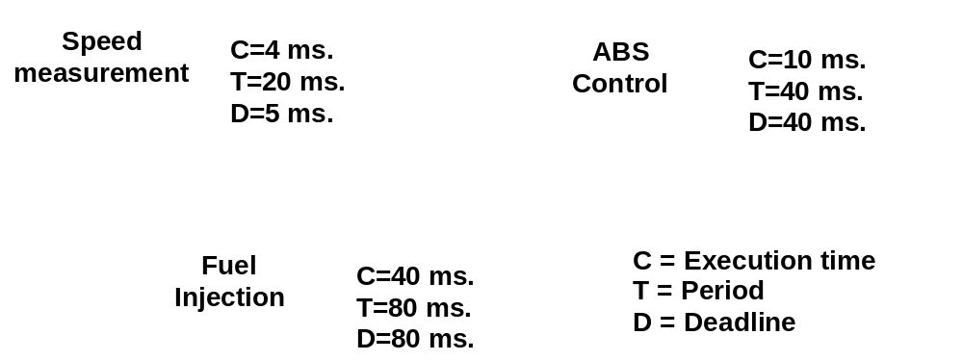
Ejemplo: lazos de control en un coche
Supongamos que se tienen los siguientes lazos de control:

Slide 9
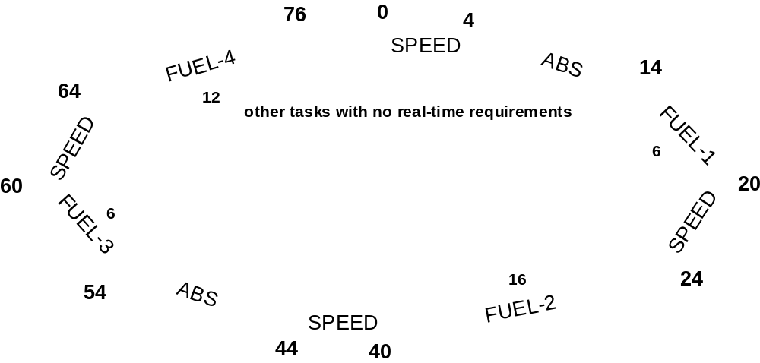
Ejemplo: Solución mediante un ejecutivo cíclico
Para conseguirlo deberemos trocear algunos lazos de control en partes que nos permitan ejecutar las tareas de menor periodo:

Slide 10
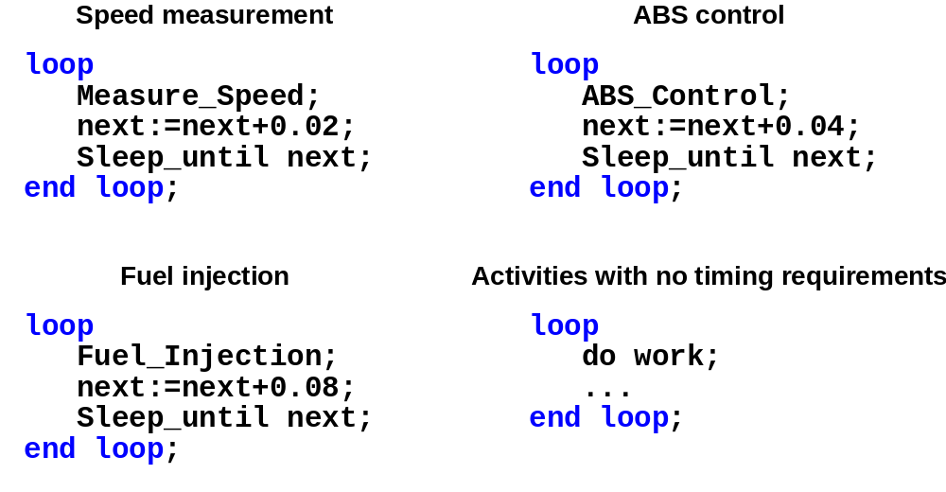
Ejemplo: Solución concurrente
Se expresan los lazos de forma independiente. Más fácil de mantener y de concebir.

Slide 11
Ejemplo: necesidad de mantenimiento
Supóngase por ejemplo que se requiere añadir una actividad aperiódica con un tiempo de ejecución de 1ms pero con un plazo de 20ms:
En la solución cíclica:
  Tendríamos que trocear todo de modo que se pudiera muestrear la condición de interrupción cada 19ms … rompiendo aún más los lazos ABS y FUEL
En la solución concurrente en cambio:
  Basta con añadir una nueva tarea con la máxima prioridad y repetir el análisis de planificabilidad para garatizar que es viable.
  No hace falta modificar el código.
Notes:
- Compile-time:
Cyclic executive - where all work (tasks) are fit into a common period (major frame) and executed non-preemptively.
- Run-time, preemptive, fixed priority:
Deadline monotonic - preemptive execution where tasks are assigned priorities based on fixed deadlines.
Rate monotonic - preemptive scheduling where tasks are assigned priorities based on rates, or periods.
- Run-time, preemptive, dynamic priority:
Earliest deadline first - preemptive scheduling, where tasks are assigned priorities dynamically, based on closeness of current deadlines.
Least laxity first - preemptive scheduling, where tasks are assigned priorities dynamically, based on the amount of slack time that remains between time needed to complete work and time to the deadline.
- Run-time, non preemptive: once a task starts executing, it runs until completion.

Slide 12
Planificación por prioridades fijas
La planificación expulsable basada en prioridades fijas es la política más popular pues:
El comportamiento temporal es el más fácil de entender
El comportamiento del sistema ante sobrecargas puntuales es fácil de manejar
Se dispone de técnicas de análisis conocidas
Facilita niveles de utilización suficientemente altos (70 a 95%)
Esta soportada por la gran mayoría de los ejecutivos estándar:
  Ada de tiempo real, Java RTSJ
  POSIX de tiempo real
Notes:
Criteria for real-time scheduling policies:
Predictability: easy to analyze and understand timing behavior
Achieve high utilization and still guarantee hard deadlines.
Provide fast aperiodic response and still guarantee hard deadlines.
Low overhead: dynamic policies tend to have higher overhead, since they may reorder the run queue at each scheduling decision.
Maintain stability under transient overload
Widely available in commercial standard products
Fixed-priority scheduling meets all these criteria, and is an excellent choice for building practical applications.

Slide 13
Planificación por prioridades dinámicas
La más conocida de ellas es “Earlies Deadline First” (EDF):
  La prioridad cambia en el tiempo, es la tarea con el plazo absoluto más próximo a expirar la que toma la CPU
  Con ella se consigues utilizaciones del 100%
Sin embargo hay que considerar que:
El comportamiento del planificador es más complejo y el análisis también
Es muy difícil analizar y gestionar la sobrecarga
No esta soportada por los SO estándar, aunque si en:
  Java RTSJ
  Ada 2005 en adelante

Slide 14
Modelado y Análisis de sistemas de tiempo real
El análisis de tiempo real se constituye en una solución de ingeniería para analizar y diseñar lo que hemos dado en llamar sistemas de tiempo real
Facilita mecanismos para determinar la asignación óptima de prioridades
Ofrece un marco analítico para validar requisitos temporales
Ayuda a identificar cuellos de botella y errores de diseño
Notes:
Scheduling theory is a mathematical approach for analyzing real-time tasks to determine their schedulability. It can be applied to a wide range of practical real-time systems.
In this tutorial, we will first introduce the mechanics of the analysis in an incremental way. First, we will start with a very restricted system for which we use the first theoretical results that appeared in rate monotonic scheduling. We will then systematically relax the assumptions and extend the basic theory to cover every aspect of a real-world system.
We will initially focus on fixed priority scheduling, but will later introduce concept of dynamic priority scheduling.

Slide 15
Porque se pueden perder los deadlines
Para una determinada tarea considérese:
  : el tiempo que se espera a tareas de mayor prioridad
  : el tiempo de ejecución propio
  : tiempo de retraso debido a tareas de menor prioridad
La tarea cumple los plazos si la suma del tiempo que es expulsada, su tiempo de ejecución y el tiempo de bloqueo aún en la situación de peor caso es menor que el plazo que tiene:
  el tiempo de ejecución es inevitable (a menos que cambie el algoritmo que se usa y en definitiva el código que ejecuta).
  El tiempo de expulsión puede ser minimizado eligiendo la asignación de prioridades óptima
El objetivo principal es identificar y reducir los tiempos de bloqueo
Notes:
For a task to meet its deadline, it must accommodate
Preemption from higher-priority tasks,
Its own execution time, and
Delays caused by lower-priority tasks (known as priority inversion or blocking).
Execution time is unavoidable, unless the code itself is modified. Preemption can be minimized by choosing the appropriate (optimum) priority assignment.If execution and optimized preemption exceed the maximum system capacity, one is faced with a classical throughput problem and the only remedy is to reduce the workload (which means changing the system requirements) or to increase the capacity by using a faster computer.
Experience has shown that priority inversion (blocking) and suboptimal preemption are major sources of missed deadlines. So we focus on identifying sources of priority inversion and suboptimal preemption, and try to reduce their effects to enhance schedulability.

Slide 16
Arquitectura y predecibilidad temporal
Las arquitecturas modernas tienen un impacto muy fuerte sobre la predecibilidad temporal de los tiempos de ejecución, en general porque optimizan la respuesta promedio, pero en particular por:
  Los “fallos” de acceso a los distintos niveles de cache
    Uso de memorias ScratchPad o deshabilitando la cache
  Los “fallos” en la ejecución condicional predictiva y en pipeline
    Análisis estático y por cotas superiores
  La falta de apertura de la industria sobre los protocolos de acceso al bus local en arquitecturas multiCore
    No usando más de un Core… (aviónica, aeroespacial…)
Véase WCET en: https://en.wikipedia.org/wiki/Worst-case_execution_time

Slide 17
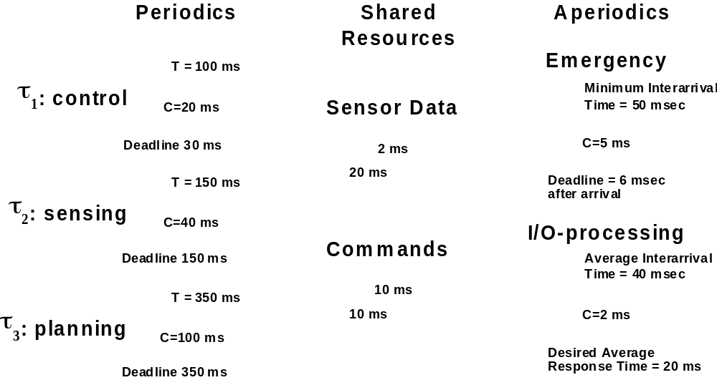
Caso de estudio

Slide 18
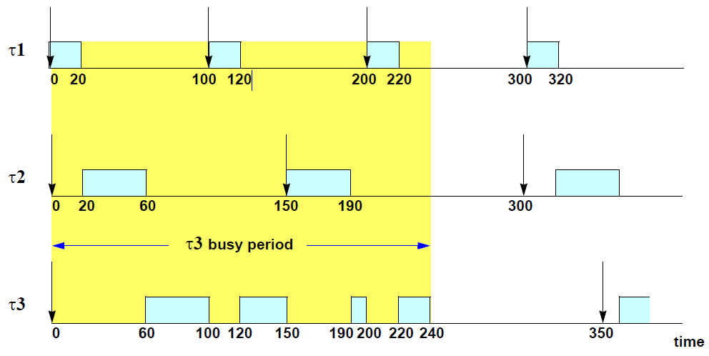
Instante crítico y respuesta temporal

Slide 19
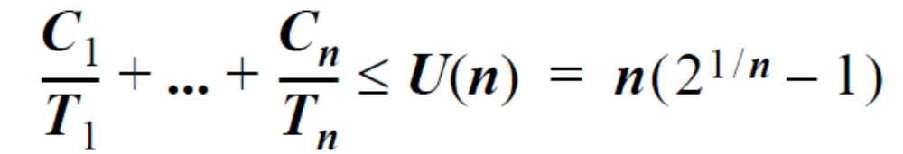
Test de Utilización
Utilization Bound Test: A set of n independent periodic tasks, with deadlines at the end of the periods, scheduled by the rate monotonic algorithm will always meet its deadlines, for all task phasings, if
U(1) = 1.0 U(4) = 0.756 U(7) = 0.728
U(2) = 0.828 U(5) = 0.743 U(8) = 0.724
U(3) = 0.779 U(6) = 0.734 U(∞) = 0.693
For harmonic task sets, the utilization bound is U(n)=1.00 for all n.

Slide 20
Recursos y herramientas disponibles
Recursos docentes, OCW de la UC:
  OCW UNICAN Sistemas de Tiempo Real
  https://ocw.unican.es/course/view.php?id=168&section=4
Herramienta para el análisis:
  MAST UNICAN
  https://mast.unican.es/
Herramienta para la programación:
  MARTE UNICAN
  https://marte.unican.es/

Slide 21
Ubicación curricular
En carreras de grado:
  En Ingeniería Informática: 1er cuatrimestre de Tercer curso (facultad de ciencias grado en ingeniería informática unican)
  https://https://web.unican.es/estudios/asignaturas?p=98&c=2018
En programas de master:
  Modelos y Herramientas / Lenguajes de programación /Patrones de diseño y modelado
  (facultad de ciencias master en ingeniería informática unican)
  https://web.unican.es/estudios/asignaturas?p=170&c=2018

Slide 22
Más información y contacto
Dudas, preguntas, sugerencias?
Punto de contacto en la UC:
  Yadran Eterovic Solano <yadran@ing.puc.cl>
Punto de contacto en la otra UC
  Julio.Medina@unican.es

Slide 23
¡¡Gracias por su atención!!!

